Slide 1

Western Governors University D210 Data Dashboard and Storytelling
Performance Assessment Task
Richard Flores
rflo147@wgu.edu
Student ID: 006771163

Slide 2


About Me
Graduate Student at WGU in the Master of Science, Data Analytics program
BSc in Physics from the University of Texas at El Paso
Former Research Assistant in Experimental Physics, BioPhotonics
Former IT Engineer at Facebook, Genentech, and Johnson & Johnson

Slide 3
Dataset Summaries
WGU Telco Churn Dataset
A telecommunications data set provided by WGU with the goal of data analysis, trend identification, and key metric comparison. The data set contains information such as customer churn, subscribed services, customer account information, and customer demographics.
The data set consists of 10,000 customers and 50 variables.
IBM Cognos Analytics – Telco Churn Dataset
A fictional telco company that provided home phone and Internet services to 7043 customers. It indicates which customers have left, stayed, or signed up for their service. Multiple important demographics are included for each customer, as well as a Satisfaction Score, Churn Score, and Customer Lifetime Value (CLTV) index.
The data set consists of 7043 Observations and 33 variables.

Slide 4
Key Results
Churn Rate
WGU Telco, overall average Churn Rate of 26.50%
IBM Telco, overall average Churn Rate of 26.54%
Statista.com reports National Average Telco Churn Rate 21%
Average Tenure
WGU subscribers tend to discontinue services after 1 year, while loyal customers have an average service length of 3.5 years.
IBM subscribers tend to discontinue services after 1.5 years, while loyal customers have an average service length of 3 years.
Noteworthy Fact
Both WGU and IBM subscribers that discontinue services have a higher average monthly charge compared to loyal customers.

Slide 5
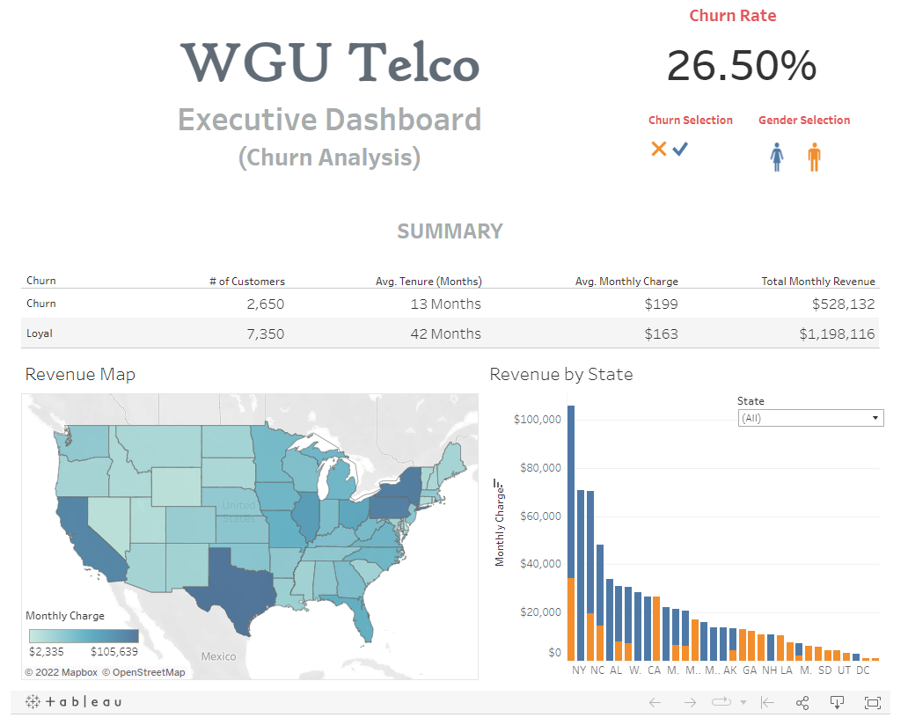

Slide 6
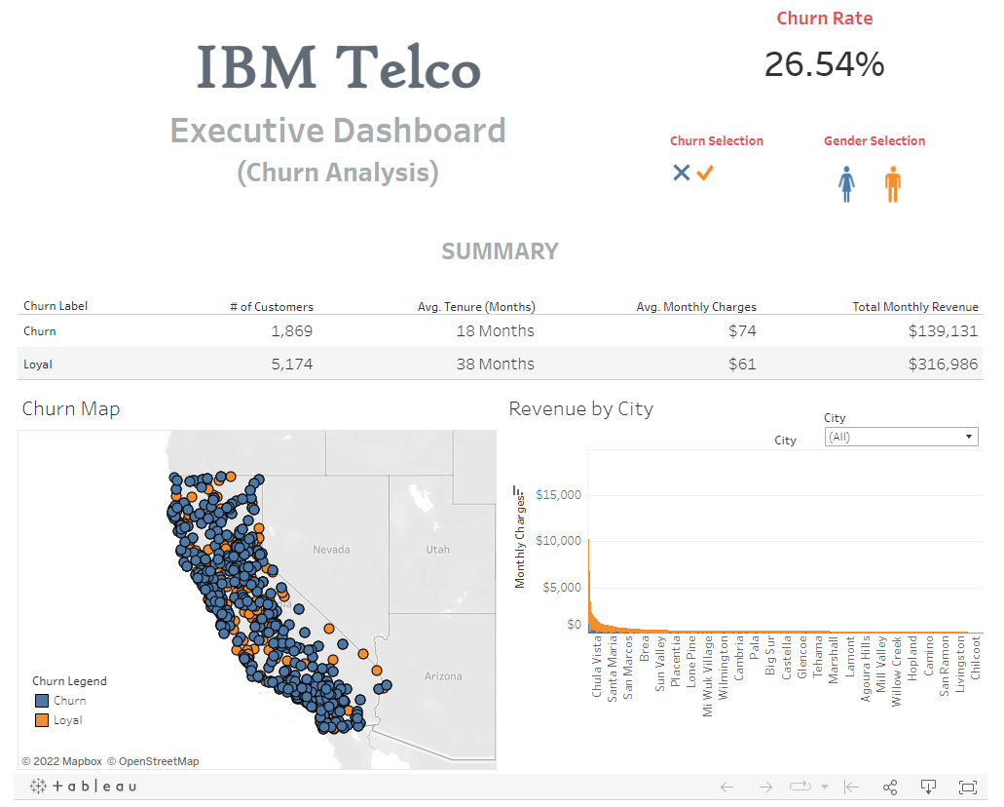

Slide 7
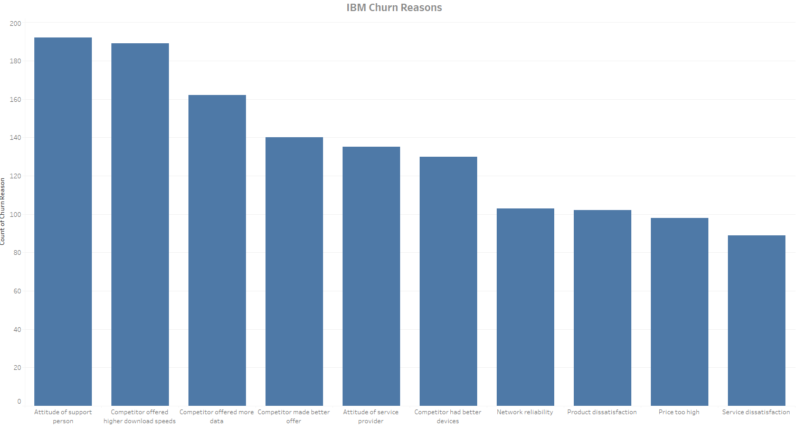
Data Representation

Slide 8
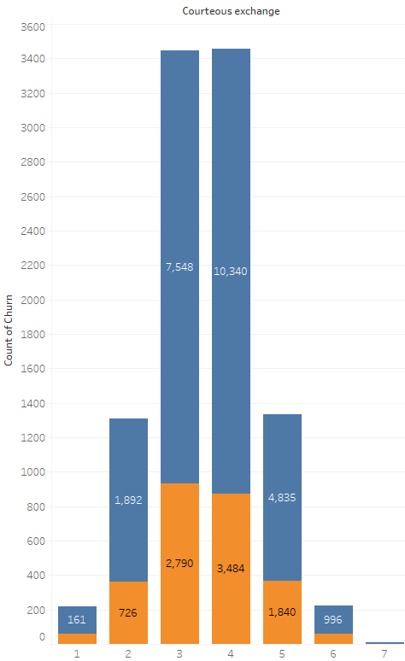
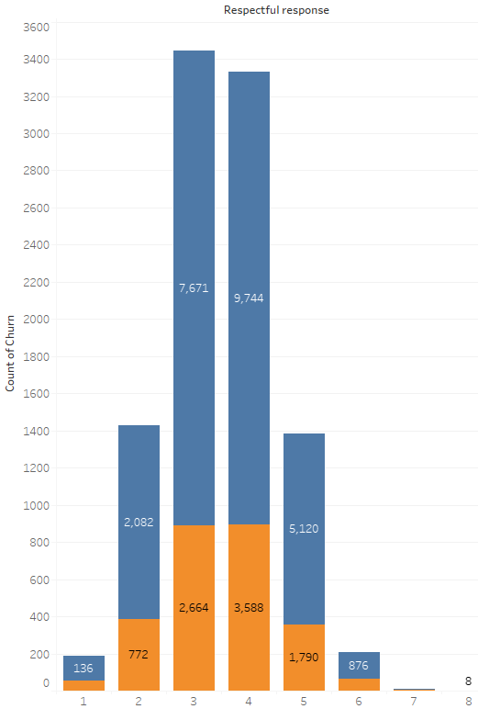
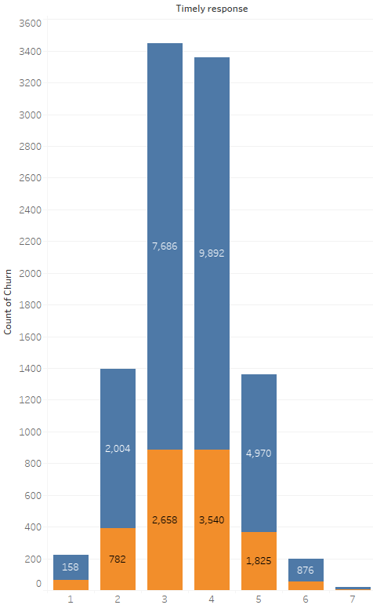
Data Representation

Slide 9
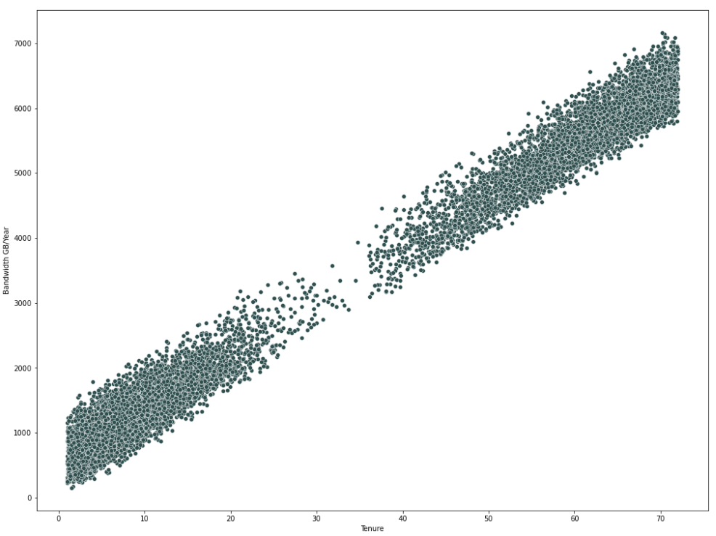
Data Representation

Slide 10
Actionable Insights
During the Exploratory Analysis, a trend common to both WGU and IBM datasets is customer churn tends to happen most often after a one-year period.
This fact was noted in the Key Results earlier in this presentation and highlights an actionable insight.
One action we can take to reduce and/or prevent churn is to boost retention efforts after a customer’s one year anniversary in the form of promotions and special discounts.

Slide 11
Actionable Insights
From our Executive Dashboard’s we can observe another important trend. A critical detail we can view in the Summary Metrics for both Dashboards is the average monthly charge divided into categories for loyal customers and those in the churn category.
In both the WGU and IBM Data, we find that customers who contribute to churn have an average bill 22% higher than loyal customers.
A great actionable insight we can gain from the data is to ensure new customers, and those with tenure less than one year only pay the average monthly price or less.

Slide 12
Actionable Insights
Finally, our greatest actionable insight into customer churn is one that is again common to both WGU and IBM customers.
IBM customers specifically state, and we can infer from WGU surveys, the greatest contributing factor to customer churn is the customer service experience.
The biggest reason customers choose to discontinue services is a direct result from a poor customer service experience.
A great actionable insight we can promote in the company is to ensure that every customer interaction is a positive experience. Simply put, customers who are treated well and with respect stay with the company, and customers who are mistreated discontinue services.

Slide 13
Summary
Actionable Insights
Offer discounts and promotions after one year of service.
Charge new customers a lower monthly rate.
Provide an excellent customer service experience.

Slide 14
Western Governors University D210 Data Dashboard and Storytelling

